Slide 1
ER Diagram and Class Diagram
1705043 – Kawshik Kumar Paul
1705060 – Maisha Rahman Mim
1605051 – Md Mahbubul Haque

Slide 2
ER Diagram

Slide 3
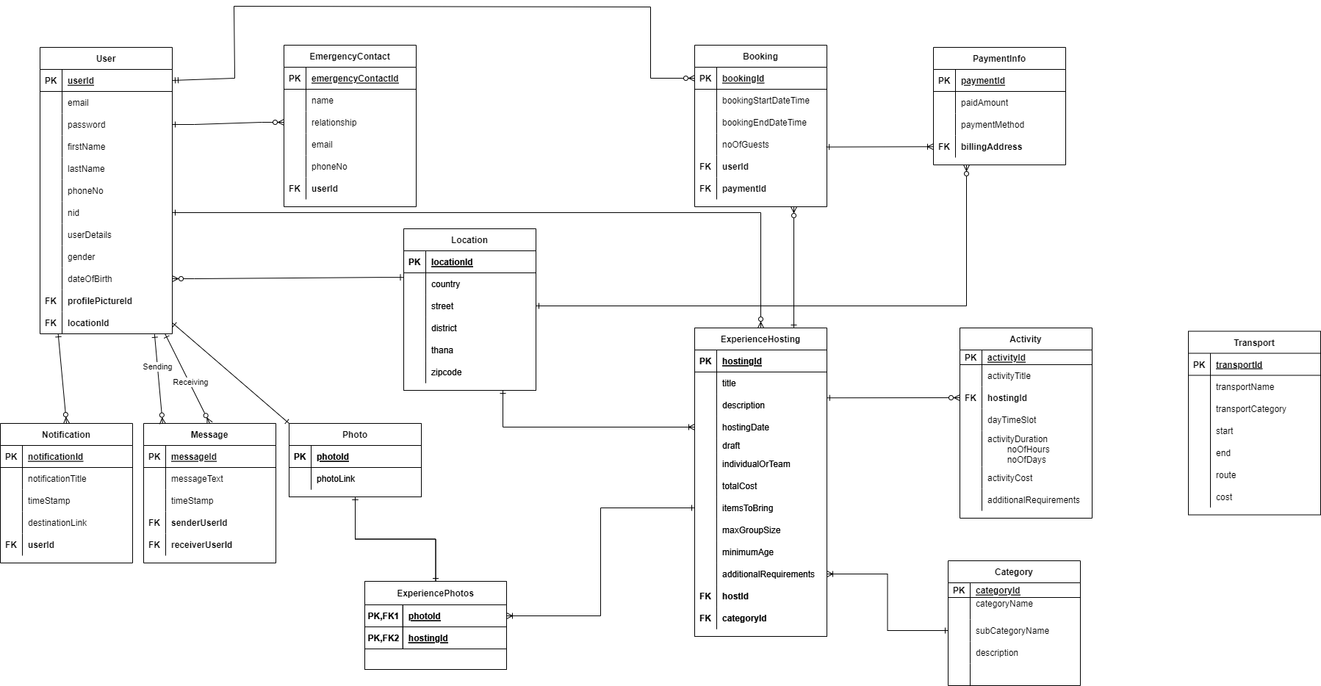
Full ERD

Slide 4
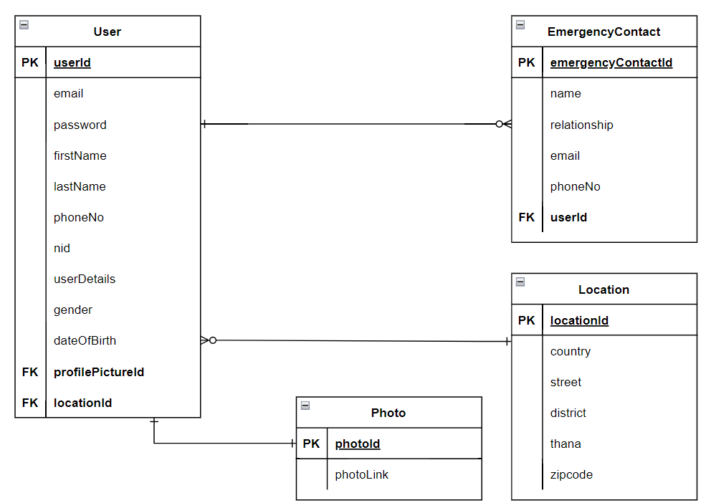
User Section

Slide 5
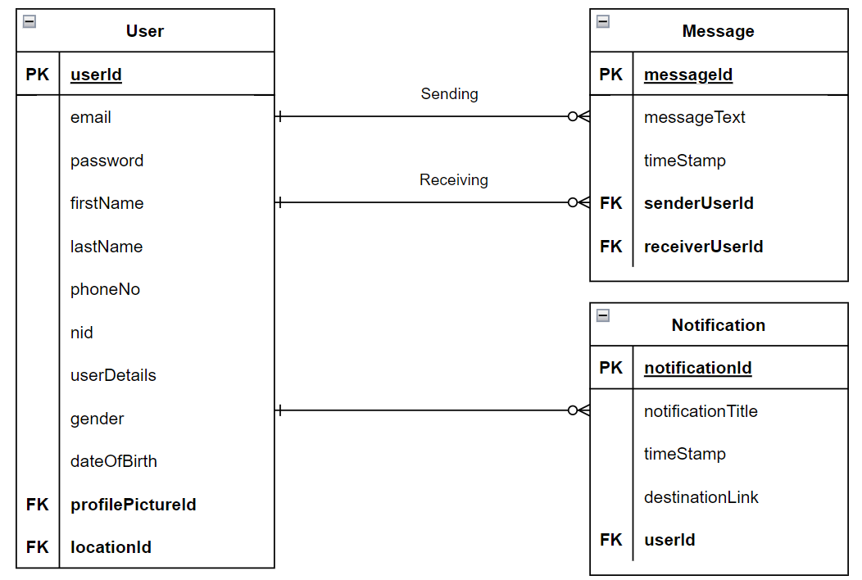
Messages & Notifications

Slide 6
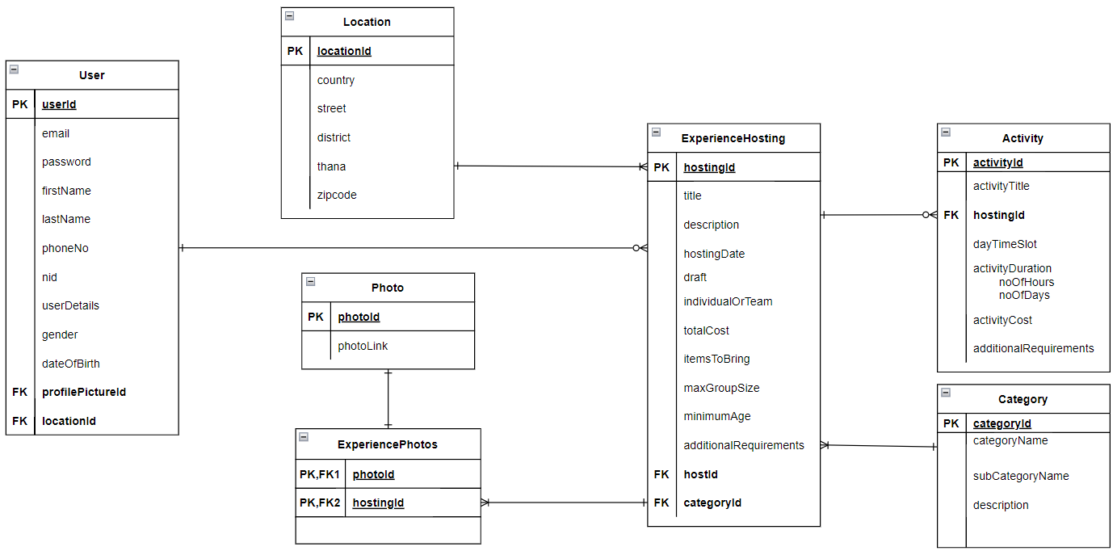
Hosting Section

Slide 7
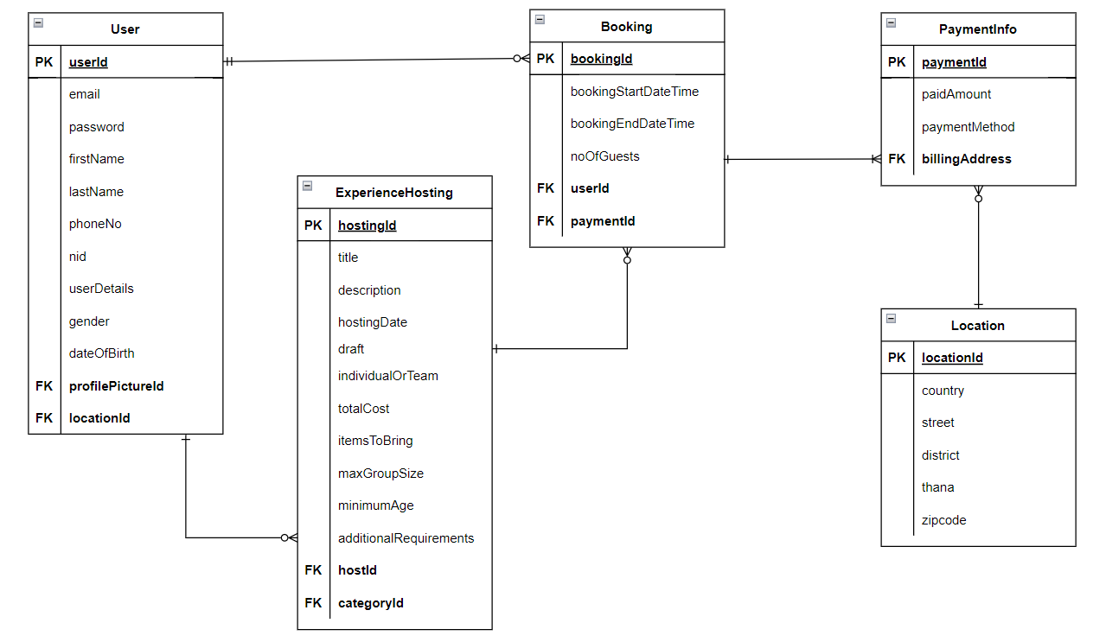
Booking Section

Slide 8
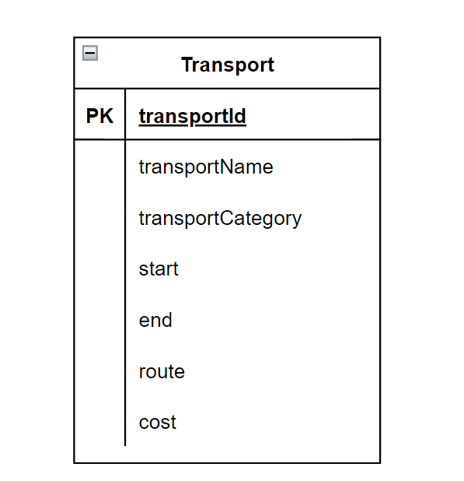
Transport Section

Slide 9
Class Diagram

Slide 10
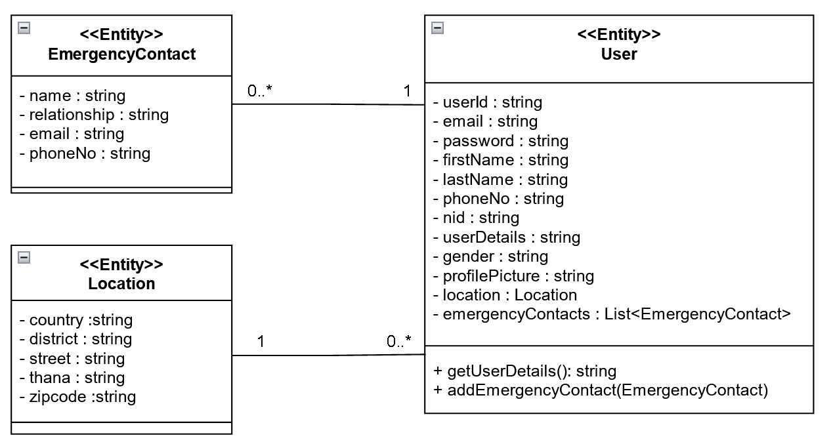

Slide 11
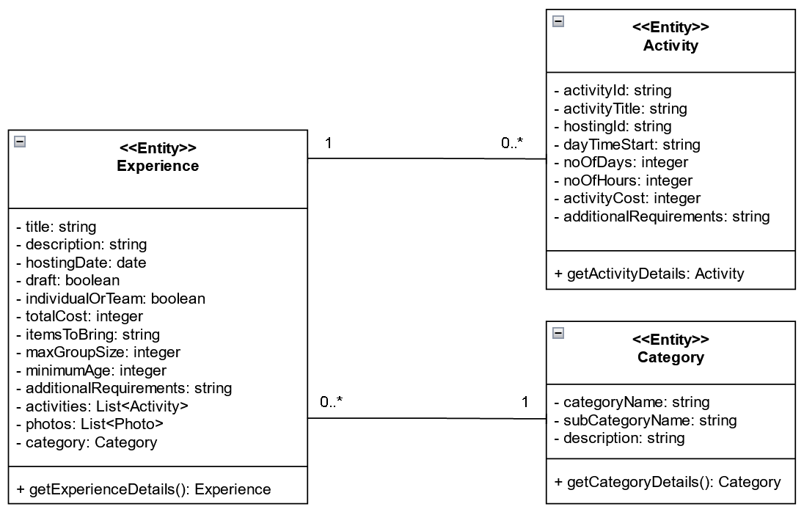

Slide 12
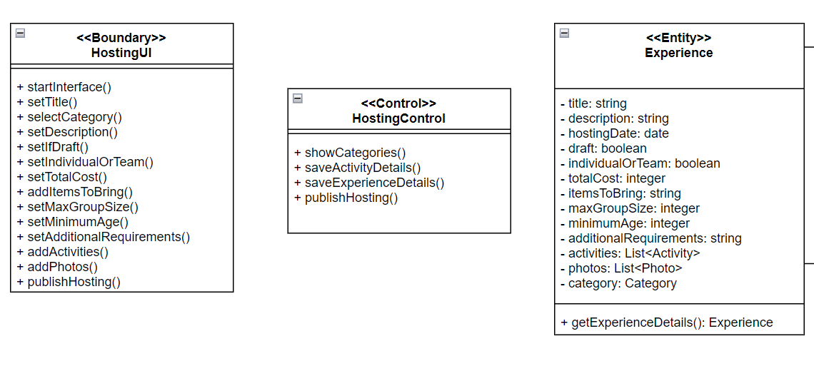

Slide 13
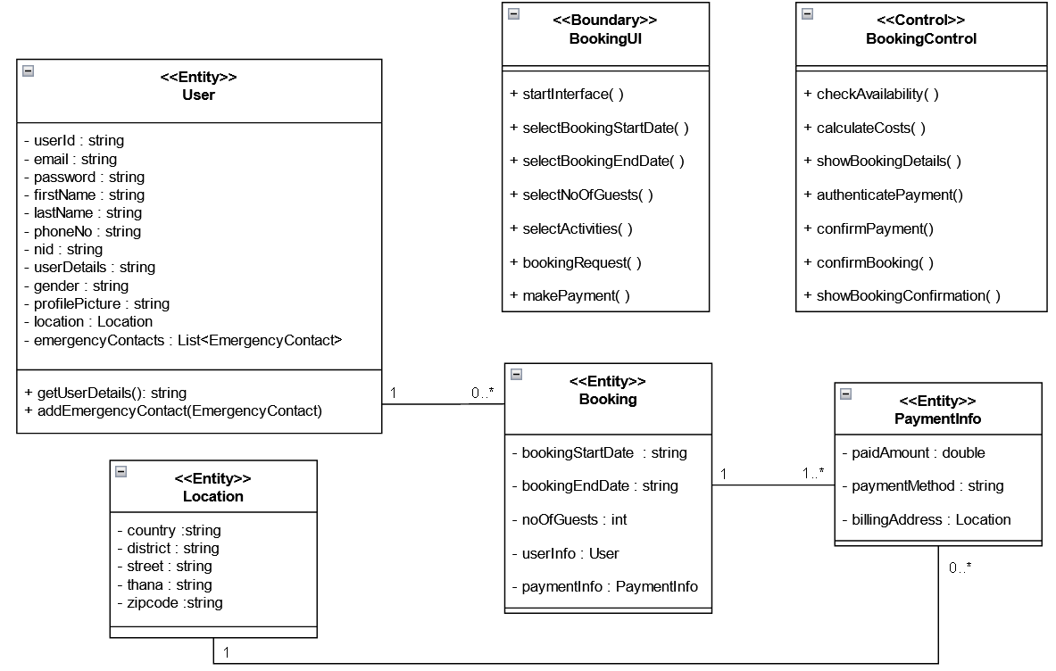

Slide 14
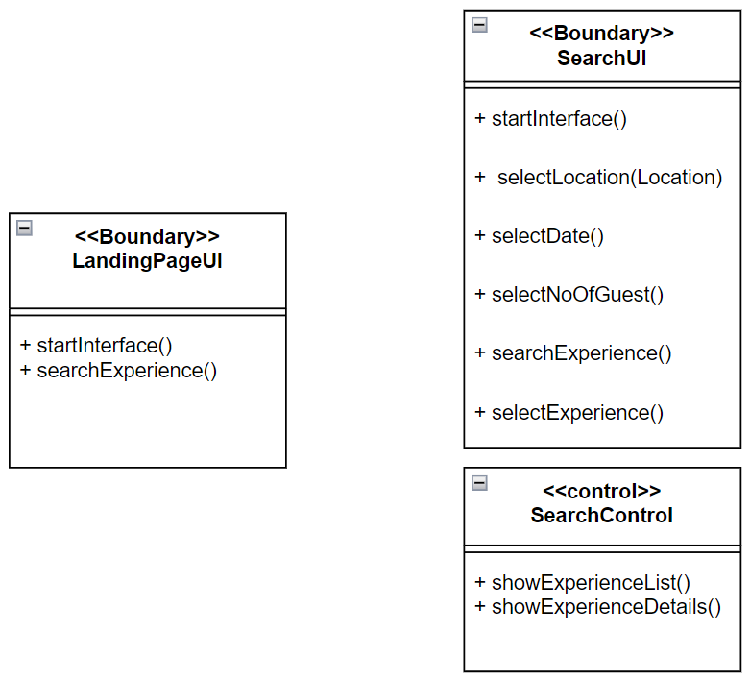

Slide 15
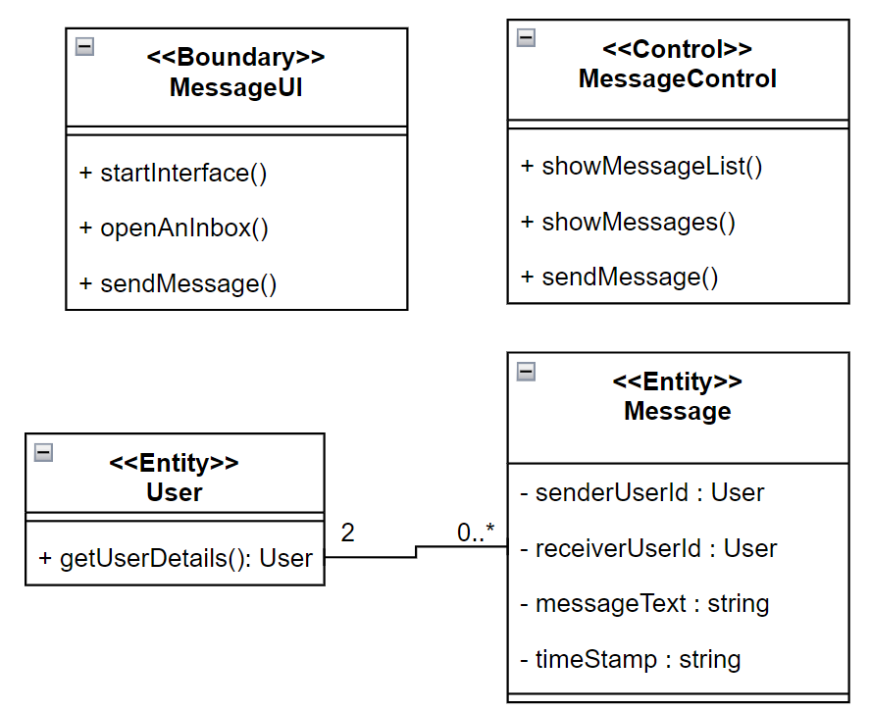

Slide 16
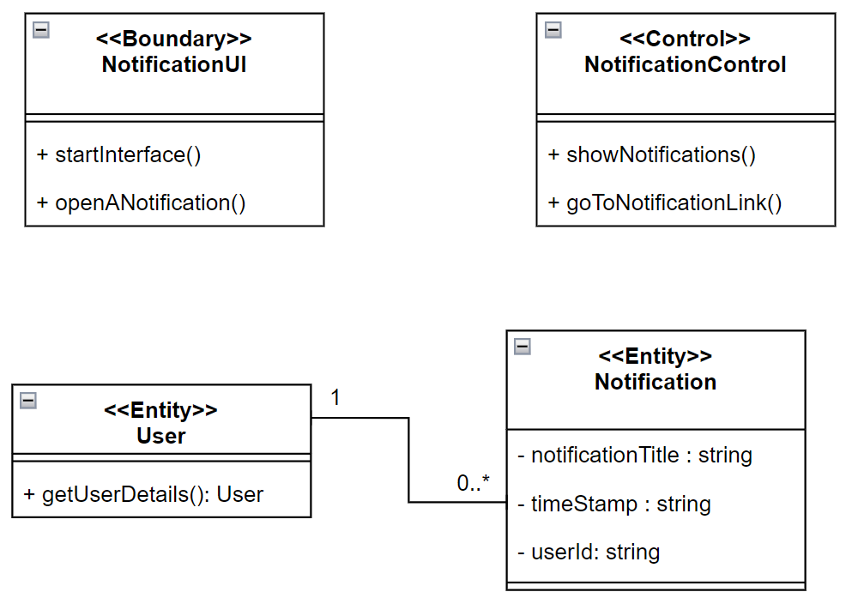

Slide 17
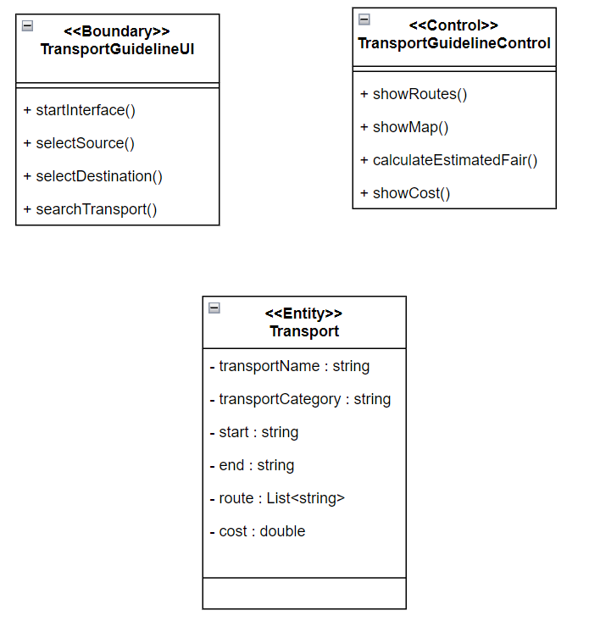

Slide 18
Thank You

